Slide 1
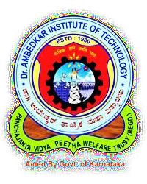
Dr. AMBEDKAR INSTITUTE OF TECHNOLOGY
Near Jnana Bharathi Campus, Bengaluru-560056.
(An Autonomous Institution, Aided by Government of Karnataka)
DEPARTMENT OF COMPUTER SCIENCE AND ENGINEERING
UG MINI PROJECT :
“PC AUTOMATION USING IR REMOTE CONTROL”.
Submitted By:
TEJAS M N
TRISHUL VISHNU K T
Project guide:
Dr. Gowrishankar S. Professor
1DA19CS179
1DA19CS181
DEPARTMENT OF COMPUTER SCIENCE AND ENGINEERING

Slide 2
Table of Contents
Introduction
Problem Statement
Objectives
Requirements Specification
Components Used
Methodology
Results and Discussions
Applications
Conclusion and Future Enhancement
Project Timeline
References

Slide 3
INTRODUCTION
In today's world need of automation is become necessary not only to reduce human effort but also to utilize maximum use of the technology and to do everything smartly and efficiently in order to reduce both energy and time consumption.
The idea of PC automation basically deals with controlling the computer and applications in it through Infrared remote just like a TV which helps users to perform their tasks comfortably without any hassle.
The use of TV remote is common everywhere. In home electronics, a remote control can be used to operate devices such as a TV set, DVD player, or any other home appliance. The same remote can be used to control personal computers also.
The main objective of this project is to develop a PC Automation system using an Arduino and IR sensor that is commonly used in an TV to automate and control applications on PC.
Although conventional way of using keyboards and mouse is easy but the functions of them are limited by the number of keys and the functions they perform.
Remote controlled PC Automation system provides the user the flexibility to assign whatever functions and shortcuts he needs to use the PC. It also gives the user the traditional feel of interacting with TV.
The result of this project shows that the IR remote has the potential to control PC also.

Slide 4
PROBLEM STATEMENT
Although we have wireless mouse and keyboard for controlling the computer it is sometimes inconvenient and uncomfortable to use them for purposes like controlling audio/video while watching movies, controlling PowerPoint presentations etc.
We need a system where user need not remember shortcuts to operate applications and can perform operations like opening, closing, moving through files etc.
In the proposed project users can reuse their old IR remotes by mapping buttons to key strokes/functions that they require to perform. Thus using a remote to control PC is more convenient and offers more freedom of movement and comfort.

Slide 5
OBJECTIVES
To study and understand the working of IR remote control and its applications.
To design and implement IR Remote control to control computer programs.
To automate user tasks that requires more than one key combination.
To effectively reuse and utilize old IR remotes.
To control computer applications with ease.

Slide 6
SOFTWARE REQUIREMENTS:
REQUIREMENTS SPECIFICATION
HARDWARE REQUIREMENTS:
Processor: Intel i7 10th Gen
Processor Speed: 2.4 GHz
Ram: 8 Gb
Hard Disk: 10 Gb
Others: Arduino UNO, IR Remote, TSOP 1838 Receiver
Operating System: Windows 7/8/10/11
Integrated Development Environment: Visual Studio Code, Arduino IDE
Language: Arduino C/C++ with IR Remote Library, Python
Python Libraries: tkinter (For Frontend), serial, pyautogui, threading (For Backend)

Slide 7
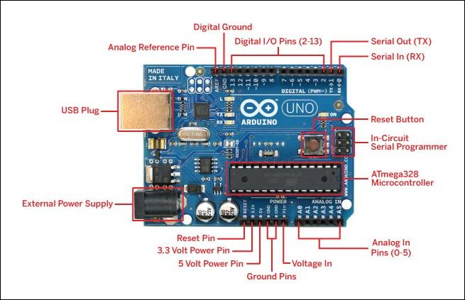
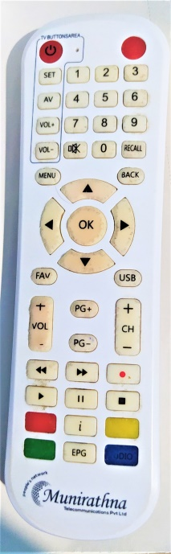
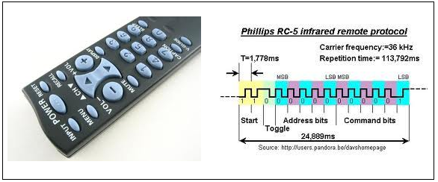
COMPONENTS USED
ARDUINO UNO
The Arduino Uno is an open source microcontroller board based on the Microchip ATmega328P microcontroller and developed by Arduino Company.
IR REMOTE
The IR remote is generally used in home theatres and is based on the principle of using infrared light as the medium of communication. Today’s modern remote controls work by modulating the output from an infra-red LED.

Slide 8
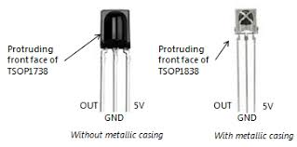
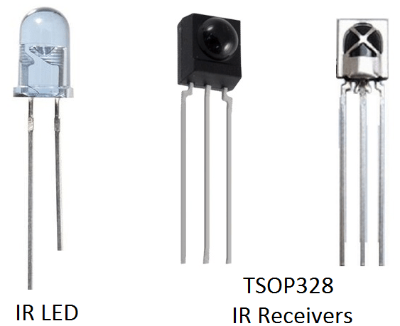
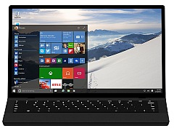
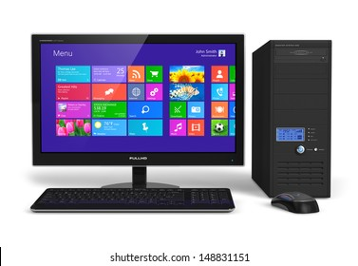
IR RECEIVER
TSOP1738 is an IR receiver with an amplifier that acts as a switch and converter within a circuit. The basic purpose of TSOP1738 is to convert the IR signal to electric signals. TSOP1738 operates on 38KHz IR frequency.
It uses silicon-based technology, which works at the micro level and very sensitive and efficient to its functions. In summary, TSOP may be smaller in size but its usage with microcontroller and microprocessors makes it smart and secure. TSOP1838 is an improved version of TSOP1738.
PERSONAL COMPUTER
A personal computer (PC) is a multi-purpose microcomputer whose size, capabilities, and price make it feasible for individual use. Personal computers are intended to be operated directly by an end user. Personal computer can be either a desktop or laptop. It contains system software and application software that are used by the end users. Applications like MS Word, MS PowerPoint, camera, music

Slide 9
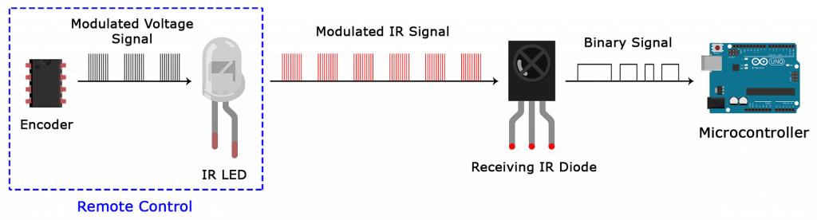
METHODOLOGY
Personal Computer (PC)
Binary
Signal
Serial
Data
Python Tkinter
Application
TSOP 1838
IR Receiver
Arduino
MicroController
Serial
Pyautogui
Modulated
IR Signal
Serial
Communication
Remote Control
IR LED
Triggers
Modulated
Voltage
Signal
Events (click , keyPress etc.)
Encoder
IR Modulation & Demodulation
Performs
User Tasks (play/pause, presentation control etc. )
User presses buttons on IR remote
Block diagram

Slide 10
WORKING
When any button of the IR Remote is pressed, the remote sends a code in form of train of encoded pulses using 38Khz modulating frequency.
These pulses are received by TSOP1838 sensor and read by Arduino and it decodes received train of pulse into a hex/bin value and in turn will display it on the serial monitor.
Once you run the Python program a GUI application designed using tkinter opens prompting for the serial port through which it communicates to Arduino. Once the connection is established.
Arduino continuously monitors the infrared receivers. Once the signal from remote is received by Arduino,
The python program fetches these codes through serial communication using serial module and assigns specific functions which will be simulate events like mouse click , keypress etc. using the pyautogui module that performs particular task like controlling volume , play/pause, presentation etc.

Slide 11
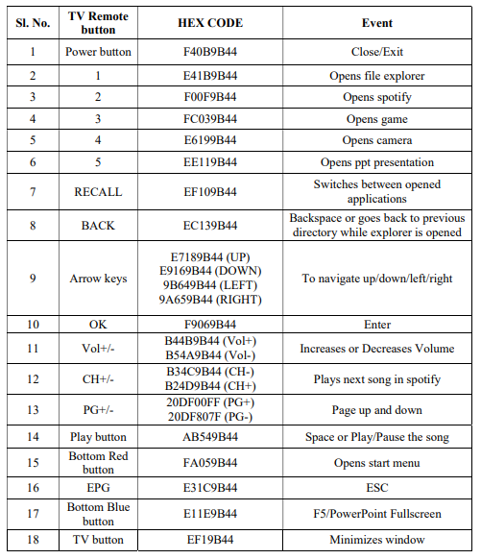
Decoding & Mapping of TV buttons to events
For decoding IR codes programmatically an Arduino program is written using IR remote library which runs repeatedly and constantly monitors the IR receiver pin for incoming signals.
Once it detects the IR signal it decodes it into hexadecimal (HEX) code and sends the data through the serial communication (COM) port.
This data can be accessed by other applications through the use of builtin libraries like pyserial in python which further can be processed for obtaining useful insights and other applications.
The mapping of IR Codes of TV remote to events that need to performed is shown in the figure

Slide 12
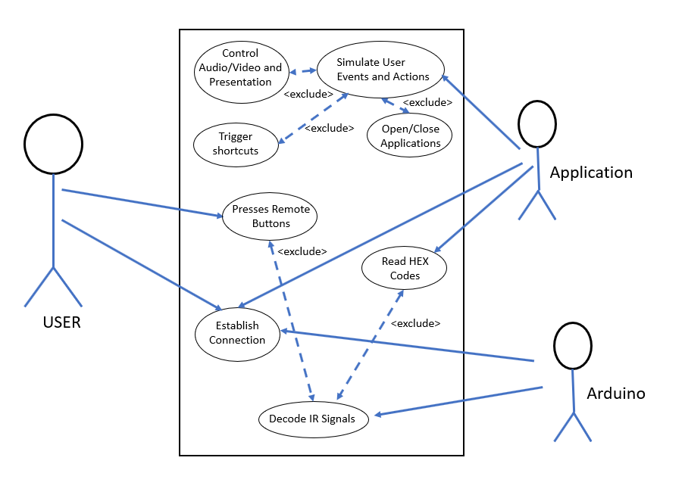
USE CASE DIAGRAM
A use case diagram is a dynamic or behaviour diagram in UML (Unified Modelling Language).
Use case diagrams model the functionality of a system using actors and use cases.
Use cases are a set of actions, services, and functions that the system needs to perform.
In this context, a "system" is something being developed or operated, such as a web site.
The "actors" are people or entities operating under defined roles within the system.
Proposed System

Slide 13
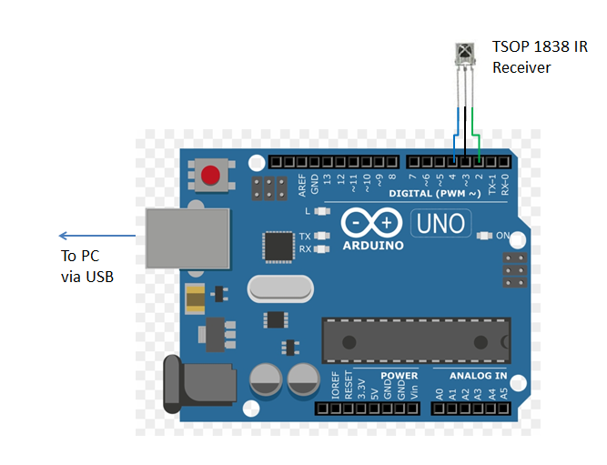
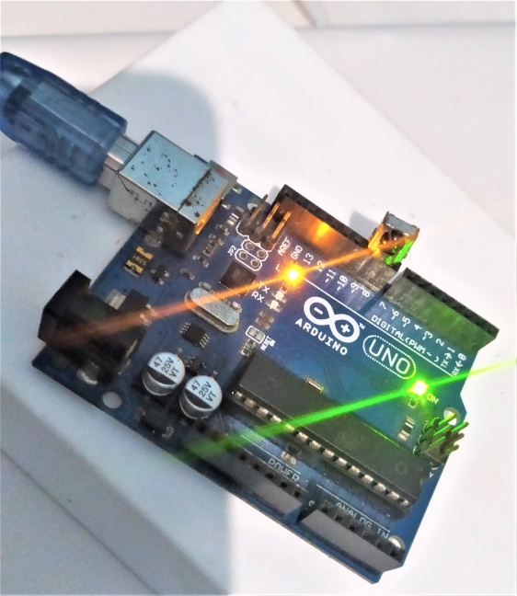
Circuit Diagram of Proposed system:
TSOP 1838 IR Receiver connected to Arduino
Arduino UNO ready to receive signal from IR remote

Slide 14
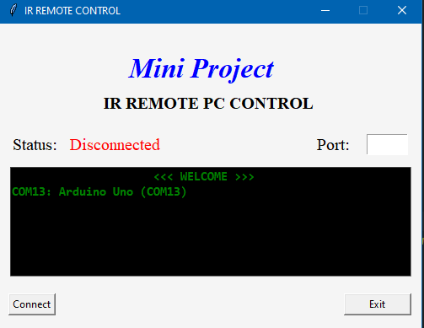
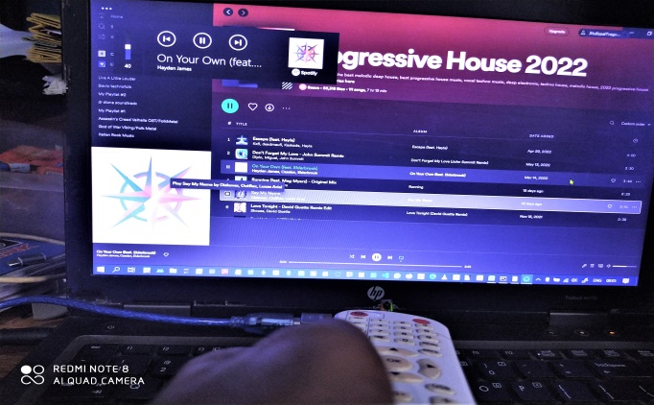
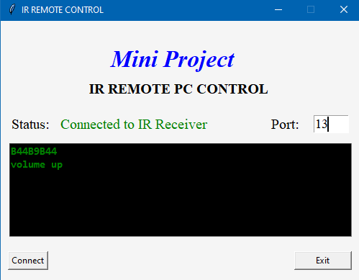
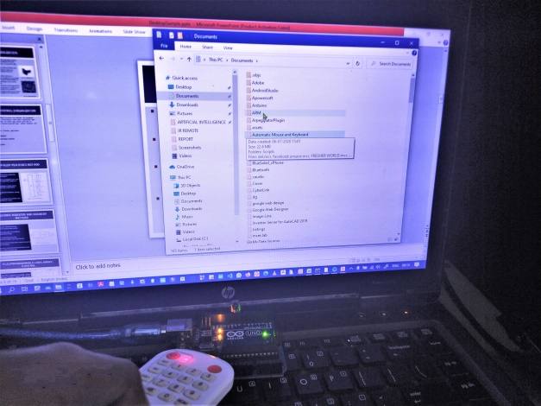
RESULTS AND DISCUSSION
Application not connected to Arduino
Controlling volume up and down using TV remote
Application connected to Arduino on port 13
And ready to receive commands
Navigating through files

Slide 15
The objectives presented in Chapter 2 created a solid base for the project. We were able to:
control the volume and playback of songs like increasing or decreasing volume, play/pause the song and changing the songs.
open file explorer automatically by pressing button one on the remote.
navigate through files and folders.
switch between multiple applications.
open power point presentation automatically and moving through slides was easier through handheld TV remote.
Examination of the code revealed that major time in processing the IR codes was consumed by the GUI application since it has to update the window constantly to display the necessary IR codes. Also due to environmental and other physical factors we observed that there were random IR codes generated and this increased latency when a button is pressed and when the particular event mapped to that button triggers. However, we were able to reduce the latency by making the time taken to update GUI to lesser values around zero to two. This reduced the latency and IR codes were interpreted and processed fast.

Slide 16
APPLICATIONS
Home Automation projects : Infrared Remote can control AC’s , TV’s and lights.
Home security systems: Infrared Night Vision Cameras with remote
Infrared remote controlled toys: Just like how we control TV’s we have IR remotes that control toys.
Fire detection: Infrared Flame detectors and IR cameras can detect hot regions as well as flames.
Distance measurement / Proximity sensors: IR receiver detects reflected light from an object to measure distance usually used in phones to prevent uneven touch during call or in pocket.

Slide 17
CONCLUSIONS AND FUTURE ENHANCEMENTS
It can be concluded that the project has met all the expectations that we had, and has been working successfully as intended. The application can perform many user actions like controlling audio/video and presentations, navigating to folders and files, opening and using favorite applications etc.
And all of this can be done wirelessly via any IR remote from 10-20m distance easily giving a traditional feel of TV. Also this project can reuse old remotes that are not in use by decoding their codes and assigning user functions to these codes.
Future enhancements and improvements can be made to the project to make it even more flexible and more responsive. Cross platform support can be added to work on multiple operating systems effectively.
New features can be added to the existing project where users can themselves map remote buttons to which ever keystrokes and shortcuts they need making it user friendly.
Multi Remote support can be added where the application can support remotes from different vendors.

Slide 18
PROJECT TIMELINE

Slide 19
REFERENCES
[1] Samiran Maiti and Pabitra Kumar Nandi, “IR Remote Control Signal Decoder For Home Automation”, IJESIT, Vol3, Issue 3, 2014.
[2] Ukachi Osisiogu, “Utilization of Serial Communication in Arduino”, Research Gate, Awka, 2015.
[3] Leo Louis, “Working Principle of Arduino and Using it as a Tool for Study and Research”, International Journal of Control, Automation, Communication and Systems (IJCACS), Vol.1, No.2, 2016.
[4] Krishna Kattabiranam, “How to set up an IR remote and receiver on an Arduino”, Circuit Basisc.com, 2020.
[5] David Anmos, ”Python GUI Programming with Tkinter”, realpython.com, 2022.

Slide 20
THANK YOU

